Slide 1
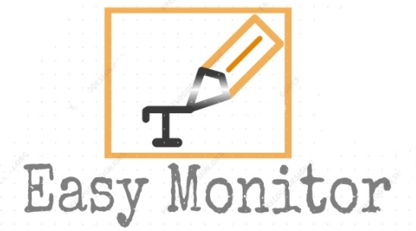

EASY MONITOR Monitors your progress Team: LoremIpsum3.0 Team Members: Aman Bharti Apurva Parashar Krishnam Srivastava Sakshi Sinha

Slide 2
rs
Problem Statement
Nowadays everything is pushed online due to ongoing pandemic including education. All schools and colleges are conducting their classes as well as examinations online. Since, examinations are being held online, there is no one to monitor the students in their semester or term examinations. They copy stuffs from internet and exchange their answers online very easily. The professors on the other hand got a problem to grade the students since all the students write the answers correctly. They then put some random grades based on figures, handwritings and other irrelevant stuffs. As a result, there is a possibility that students who copied from others might get better grade than the student who actually wrote it all by himself. So, we build a web application that acts as a communication system between the students and professors through which he can detect plagiarism. It will instantly show if students has copied things from internet. It also shows forged clustering that is clusters of students who copied from another.

Slide 3
Idea
We have made a communication system between students and professors to keep them focused and organized during this ongoing pandemic. It can be used in conducting online written examinations. Following are the features of our project:
Plagiarism detection
Tasks can be assigned to students by professors and former’s submission can be viewed.
Tracks subject-wise marks and previously submitted assignments.
Separate portals and dashboards for students and professors.

Slide 4
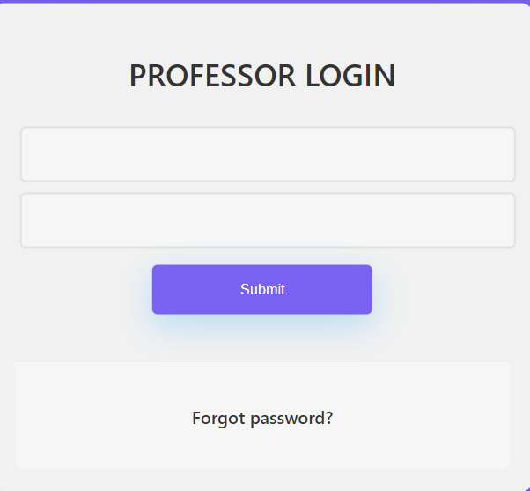
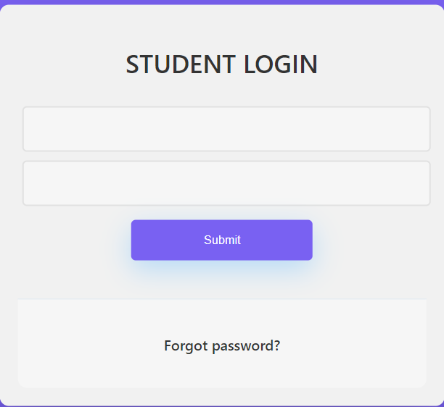
Separate portals for students and professors

Slide 5
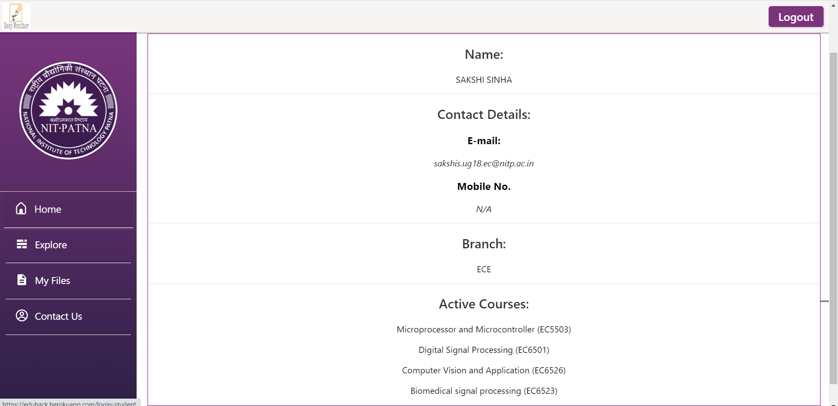
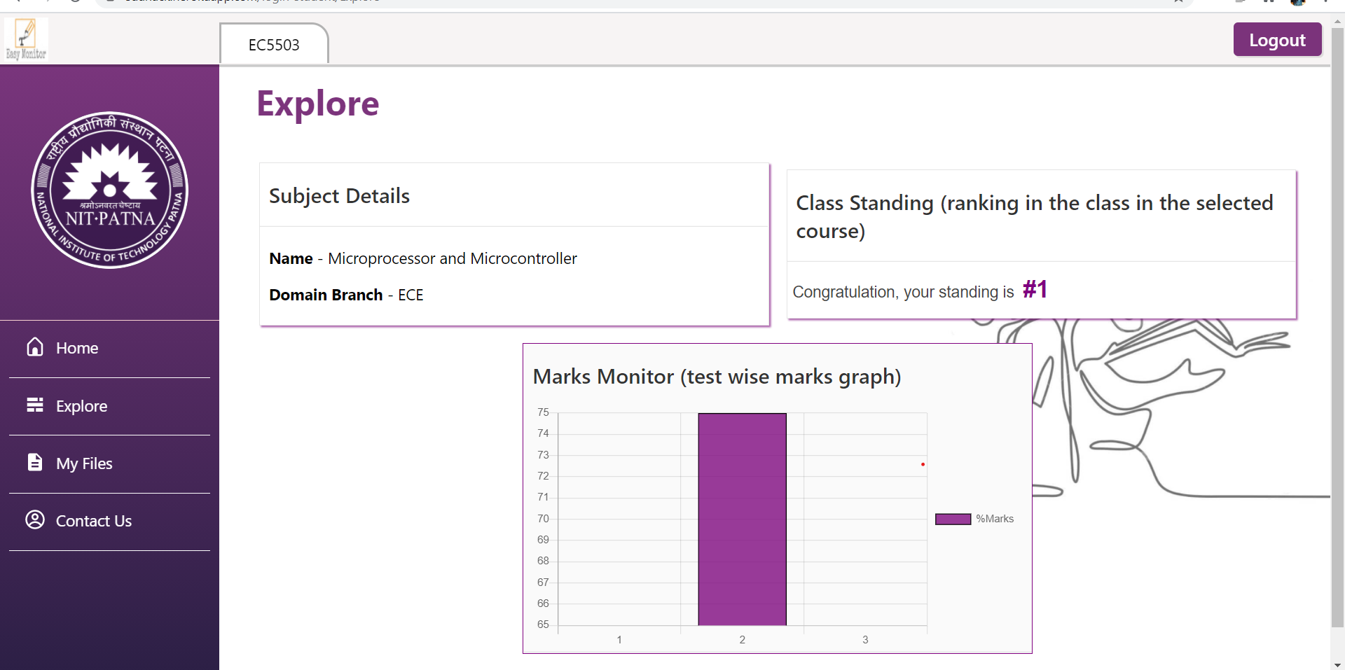
Student’s Dashboard

Slide 6
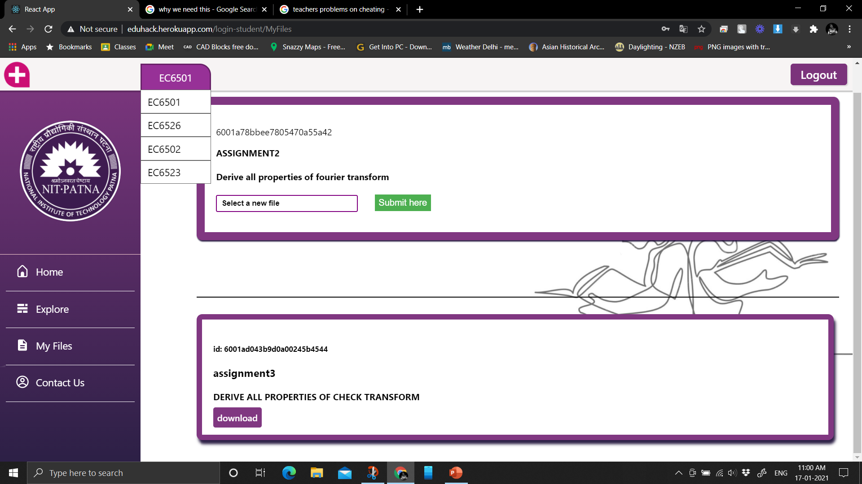
Upload assignment and download previously submitted ones

Slide 7
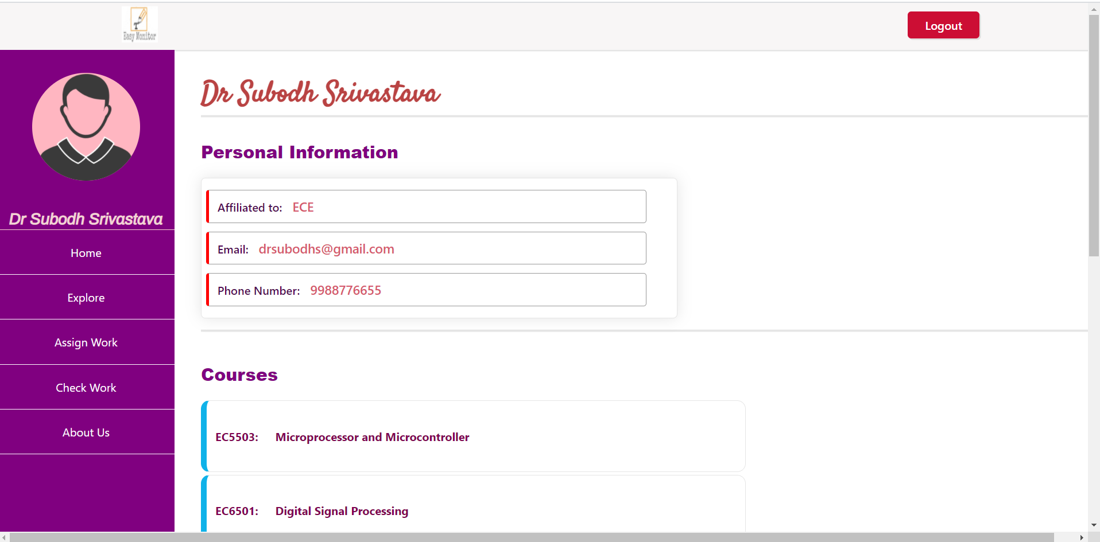
Professor’s Dashboard

Slide 8
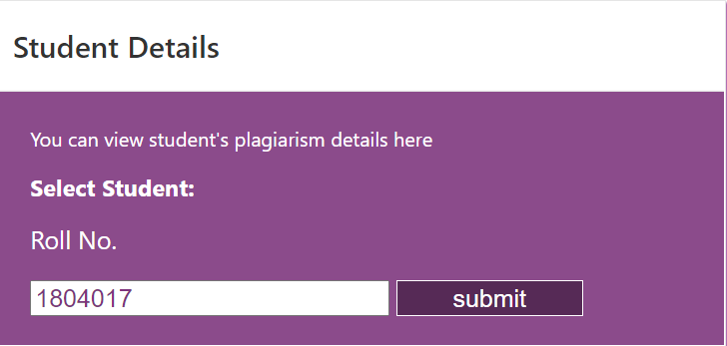
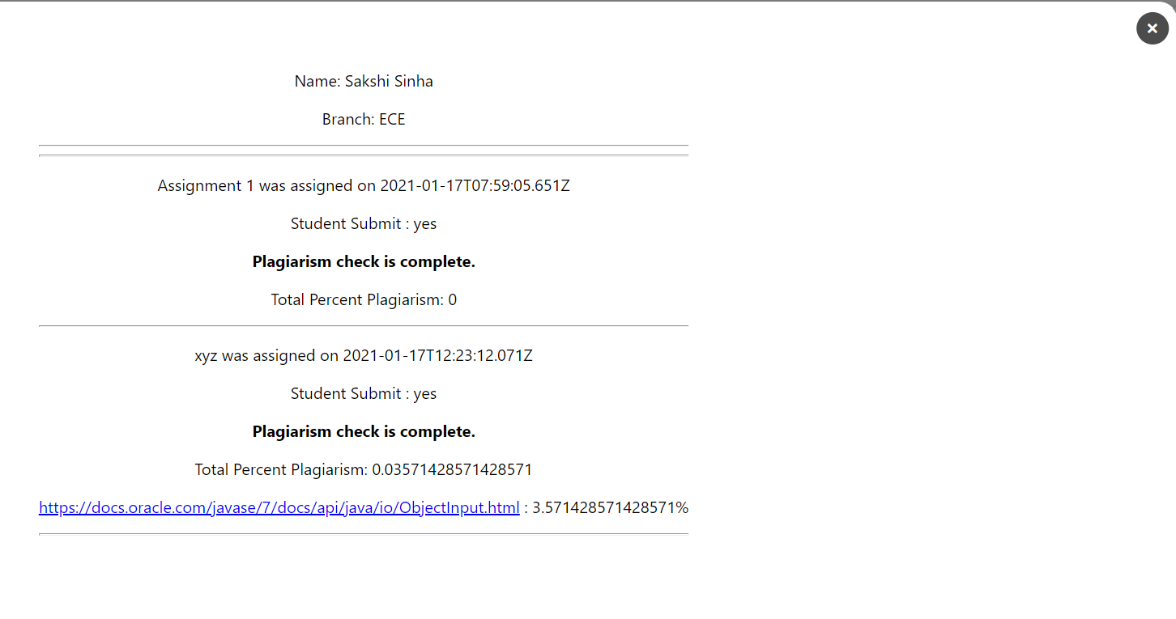
View Student’s details

Slide 9
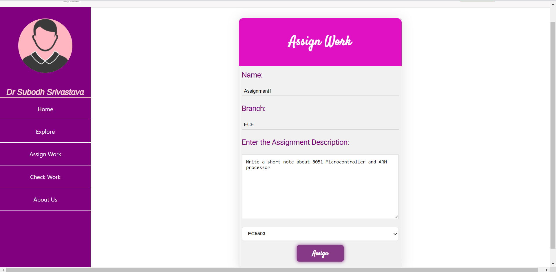
Assign tasks for students

Slide 10
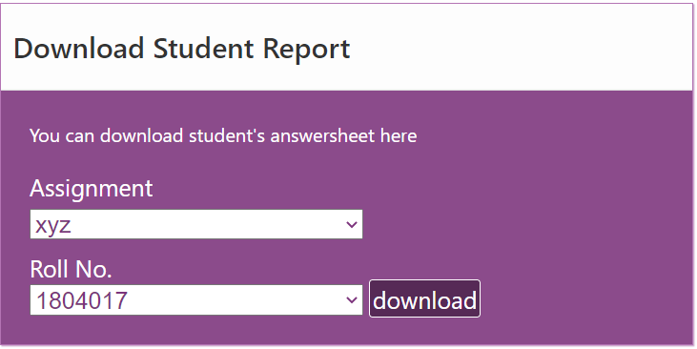
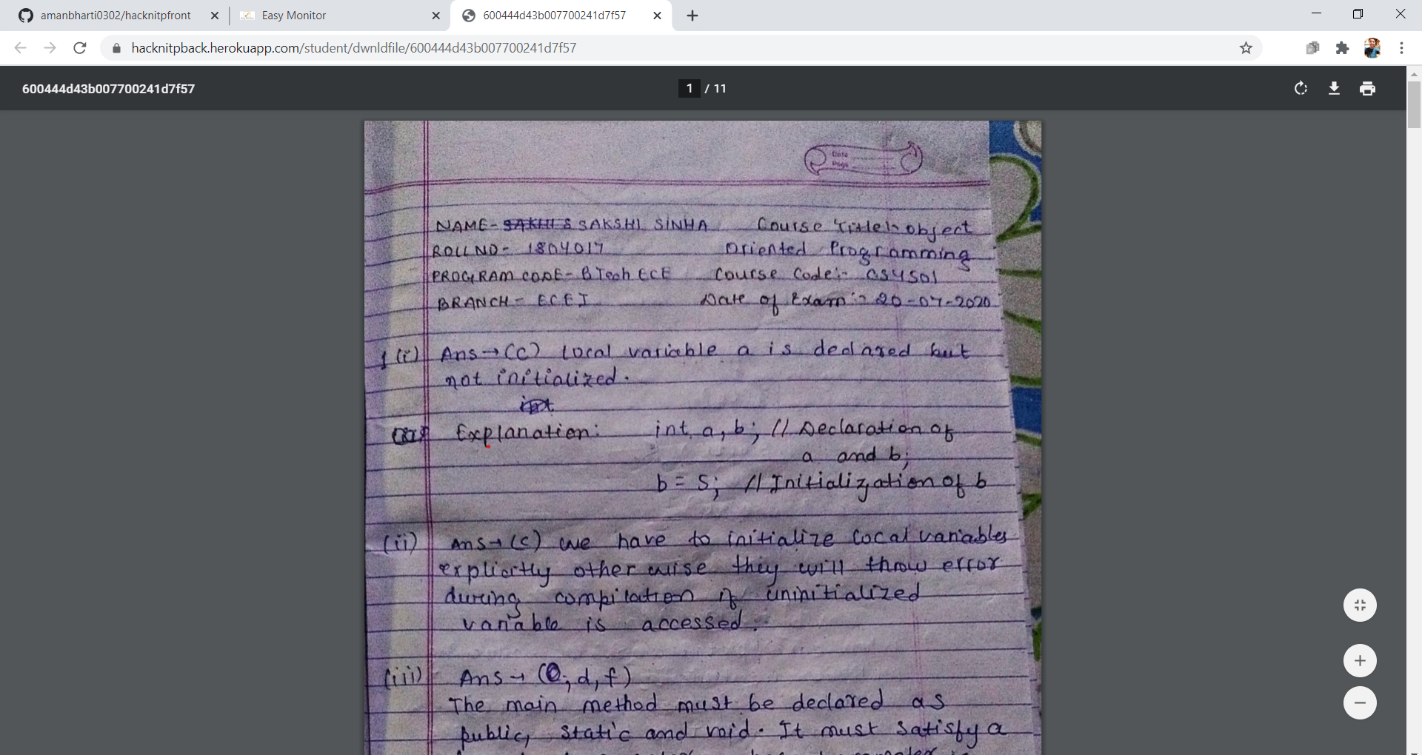
Download assignments submitted by students

Slide 11
Thank You ☺

